Slide 1

E-commerce Website – NEXUS MARKET
KRISHNA INSTITUTE OF ENGINEERING AND TECHNOLOGY
Dr. A P J ABDUL KALAM TECHNICAL UNIVERSITY, LUCKNOW
BACHELOR OF TECHNOLOGY
IN
COMPUTER SCIENCE (AI&ML)
STUDENT NAME :
Shabaz Ahmad
Shreyansh
Dipender
Shubham Pandey
Anil Kumar
SUPERVISOR NAME:
DR. Abha Kiran Rajpoot
Mr. Rajeev Kumar Singh
Dr. Sayani
Ms. Umang

Slide 2
Outline
Introduction
Proposed System
Objectives
Tools And Technologies
Methodology Used
Implementation
Result
Limitations And Future Enhancements
Conclusions

Slide 3
Introduction
Embarking on the journey of creating an online ecommerce shopping website is a visionary endeavor that encapsulates a world of possibilities.
In the digital age, where convenience and accessibility reign supreme, our mission is to provide an unmatched shopping experience for those seeking the fashion items, shoes, or the electronic items.
Our objectives are clear: to establish a strong market presence, offer a diverse and high-quality product range, prioritize customer satisfaction, and operate with the highest standards of security and trust.
As we set forth on this adventure, we invite you to explore a universe of stationery possibilities, where innovation, convenience, and a passion for creativity converge. Welcome to the future of online stationary shopping.

Slide 4
Proposed System
User-Friendly Website Interface
E-commerce Platform
Responsive Customer Support
Customer Engagement Features

Slide 5
Objectives
Convenience and Accessibility
Market Presence and Reach
Product Diversification
Product Diversification
Competitive Pricing
Security and Trust
Mobile Responsiveness

Slide 6
Tools and Technologies Used
VS Code (Editor)
HTML
CSS
Bootstrapping
Django (Framework)
Sqlite3

Slide 7
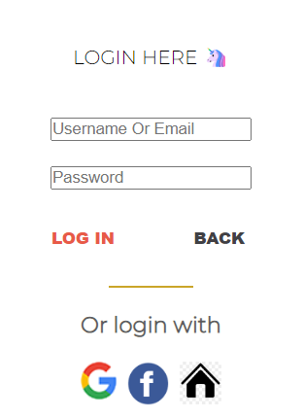

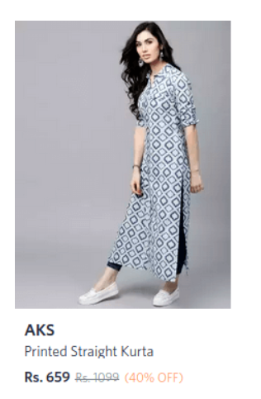

Methodology Used
Login
Home
Catagories
Product
Contact Us

Slide 8
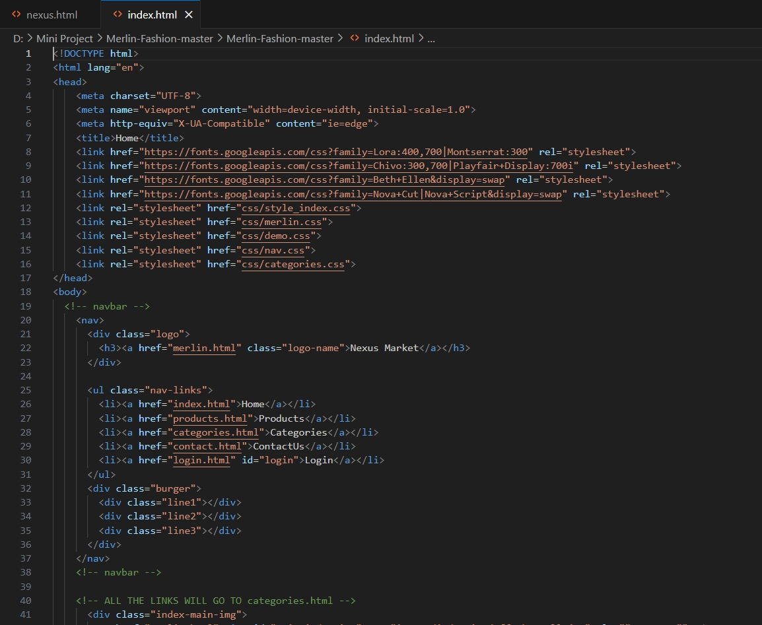
Implementation

Slide 9
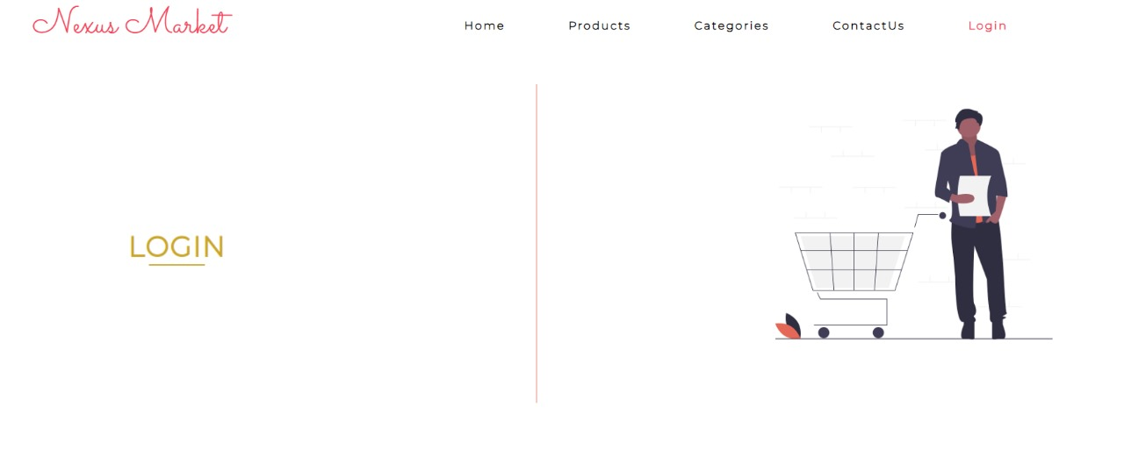
Results

Slide 10
Limitations & Future Enhancements
Limitations
Competition: The ecommerce market is highly competitive.
Buying and selling of goods, products, or services over the internet
Technological Advancements: Rapid technological advancements may require continuous website updates to stay relevant and competitive.
Future Enhancements
Mobile App Development: Develop a dedicated mobile app for a more immersive shopping experience and customer loyalty.
AI-Powered Customer Support: Implement AI chatbots for instant customer support and issue resolution, improving efficiency and response times.

Slide 11
Conclusion
In conclusion, the online ecommerce website presents a dynamic opportunity in a competitive market. While challenges like competition and supply chain disruptions exist, our proposed system, rooted in user-friendliness, security, and sustainability, promises a convenient shopping experience. Looking ahead, international expansion, emerging technologies, and a commitment to innovation will drive growth. This venture is poised to redefine stationary retail, offering customers a unique and forward-looking experience in the digital age.

Slide 12


